Slide 1

Event management system
Team members:
Mazen Ahmed Mahmoud | Sec: 11
Mazen Emad | Sec: 11
Mohaned Magdy | Sec: 15
Marko Emil | Sec: 10
Fareed Ali | Sec: 10
ENG: Asmaa Hussein

Slide 2

An Event Management System (EMS) is a tool that helps people plan, organize, and run events. It makes the process easier by helping organizers keep track of important event details, registrations, and everything that needs to be done to run a successful event.
The system allows organizers to store key information about the event, like the location, date, time, and the person or group in charge. It also helps manage how many people sign up for the event and makes sure that the event doesn't get overbooked. For ticketed events, attendees can sign up and pay through the system, and payments are processed safely.
Moreover, the system can create reports that give organizers information on how many people attended, what they thought of the event, and how much money was made. This helps organizers understand what worked well and what can be improved for future events.

Slide 3
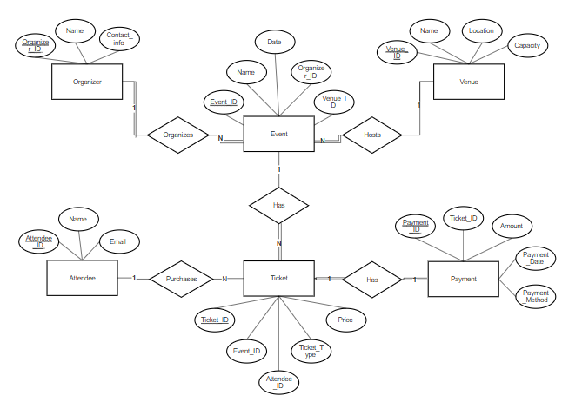
The ERD diagram:

Slide 4
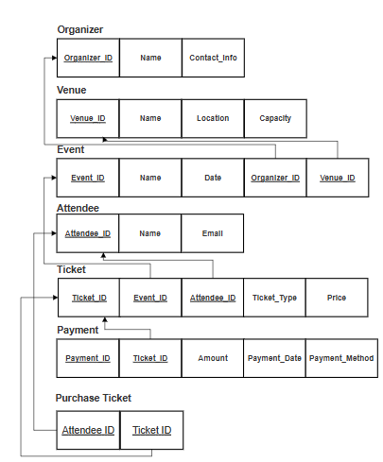
The Relational Schema for the case study:
Payment
Payment_id

Slide 5
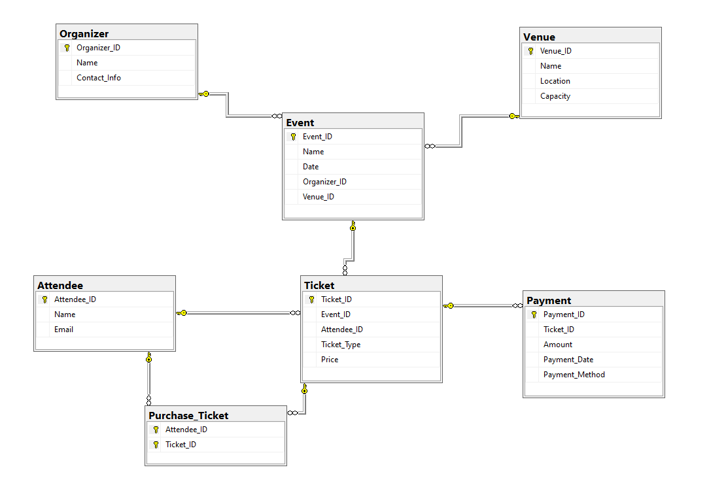
Database Diagram

Slide 6
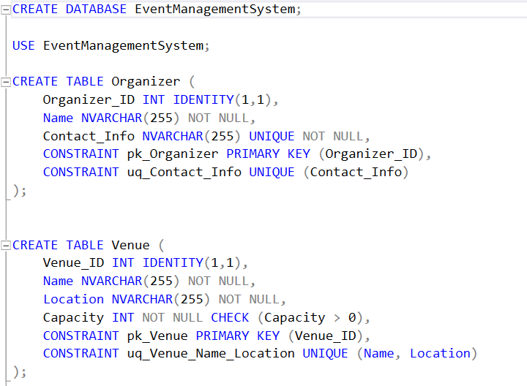
SQL SERVER CODE

Slide 7
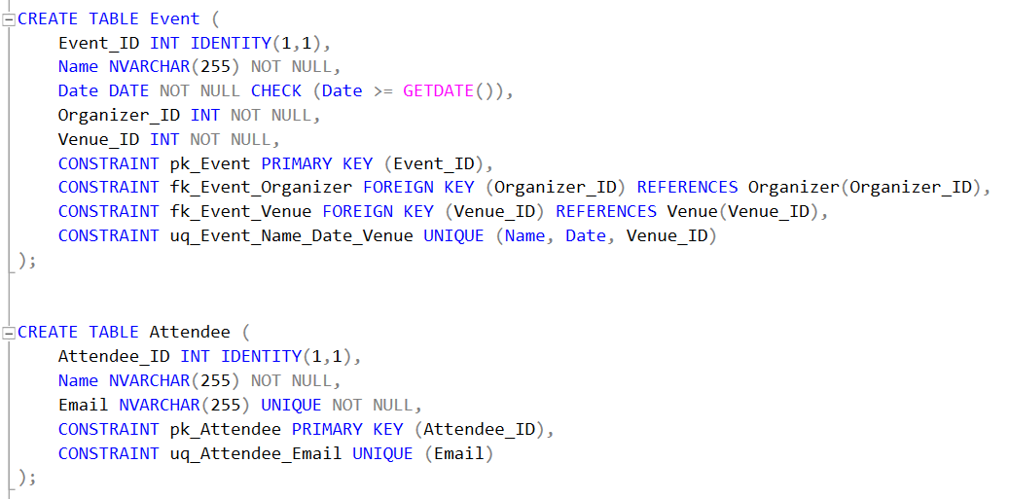

Slide 8
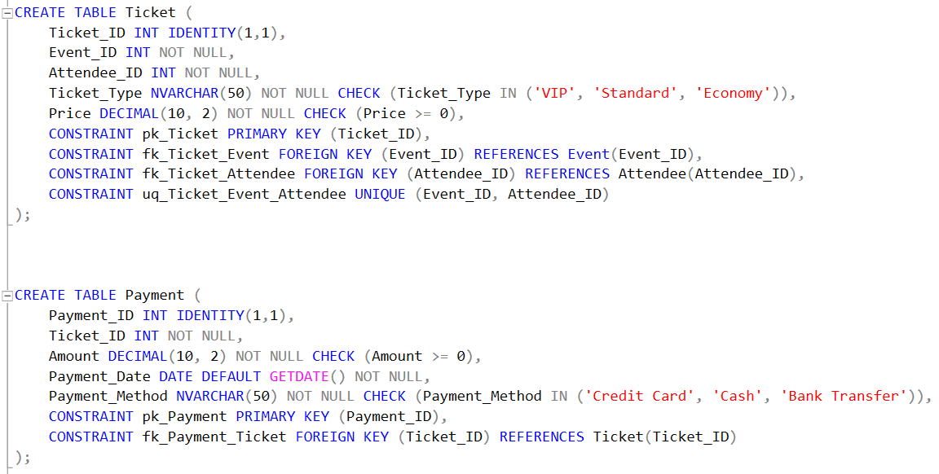
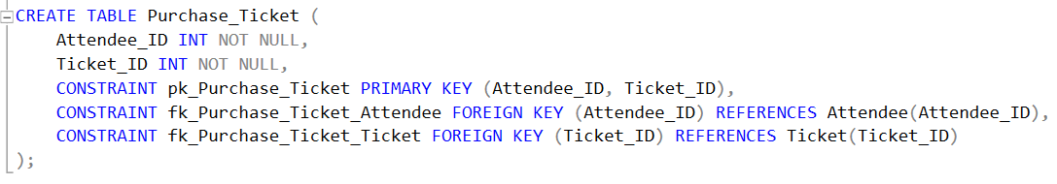

Slide 9

THANK YOU

